Slide 1
Hazards in the cleaning cabinet
Company, event, date
Name

Slide 2
Dishwashing liquid in the kitchen, fertiliser in the garden and solvents in the workroom: there are countless toxic hazards in and around the home.
Get to grips with toxins with sound basic knowledge and the necessary precautions.

Slide 3
Why do chemical products have hazard labels?
Chemical products must be handled responsibly, as chemical substances can pose a wide range of hazards.
The symbol on the label provides a first indication of the dangers associated with the product.
The safety information provides general instructions on product handling, use, protective measures, disposal and what to do in the event of an accident.
cheminfo.ch

Slide 4
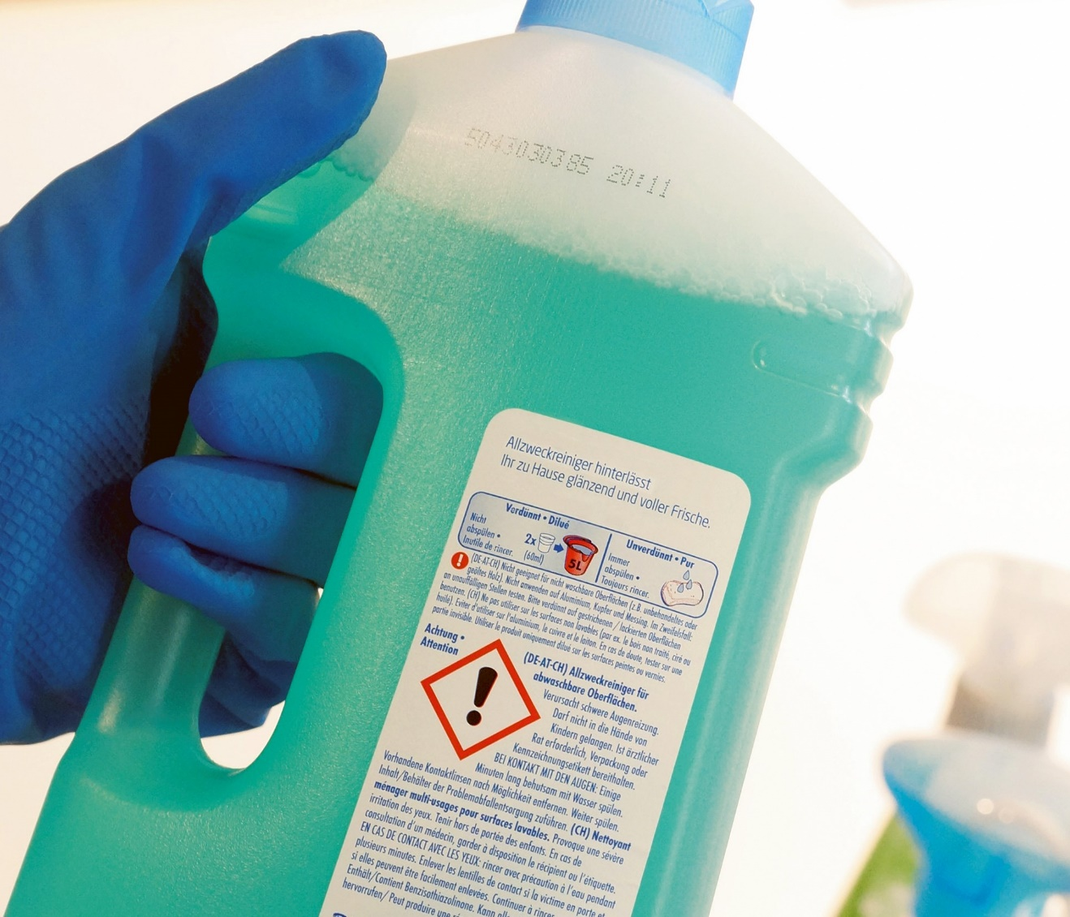
Be a conscious consumer
Pay attention to the hazard symbols and safety instructions when buying and before using a product.
Replace toxic products with non-toxic ones.

Slide 5
Use safely
Pay attention to the hazard symbols.
Follow the usage and safety instructions.
Wear appropriate protective equipment (protective gloves and/or glasses).
Make sure your work area is properly ventilated in case of toxic fumes.
Never leave products unattended.

Slide 6
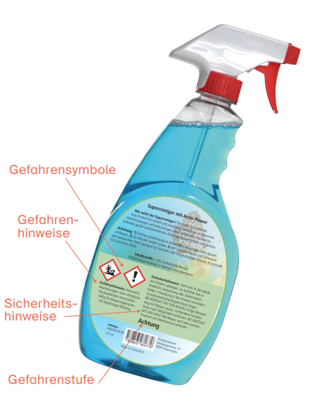
What’s on the label?
Hazard symbols: draw attention to the hazard.
Hazard warnings: provide a detailed description of the hazard.
Safety information: describes how to handle the product safely.
Hazard level: All chemicals classified as hazardous carry the signal word “danger” or “warning”.
Hazard symbols
Hazard warnings
Safety information
Hazard level

Slide 7
The 9 hazard symbols
HEALTH HAZARD
May cause skin irritation, trigger allergies or eczema, and cause drowsiness. May trigger poisoning after a single contact. May damage the ozone layer.
HIGHLY FLAMMABLE
May ignite on contact with flames and sparks, or as a result of impact, friction, heat, contact with air or water! May ignite, even without external influences, if stored incorrectly.
OXIDISING
May cause or accelerate fires. Releases oxygen when burnt and can only be extinguished with specific agents. It is impossible to smother the flames.

Slide 8
The 9 hazard symbols
EXPLOSIVE
May explode on contact with flames or sparks, or as a result of impact, friction or heat. May cause an explosion, even without external influences, if stored incorrectly.
PRESSURISED GAS
Contains compressed, liquefied or dissolved gases. Odourless or invisible gases may escape unnoticed. Heat or deformation may cause containers of compressed gas to burst.
HAZARDOUS TO THE AQUATIC ENVIRONMENT
May cause acute harm to acquatic organisms such as fish, aquatic insects and aquatic plants in low concentrations or over a prolonged period.

Slide 9
The 9 hazard symbols
CORROSIVE
May cause severe skin burns and eye damage. May dissolve certain materials (e.g. textiles). Is dangerous to animals, plants and organic material of all kinds.
SERIOUS HEALTH HAZARD
May damage certain organs. May lead to immediate or significant, long-term health impairments, cancer, or damage genetic make-up, fertility or development. May be fatal if it enters the respiratory system.
HIGHLY TOXIC
Even small quantities may lead to severe poisoning and death.

Slide 10
Storage and disposal
Keep toxic products and medicines out of children’s reach. A lockable cabinet mounted at a height of at least 160 cm is suitable for safe storage.
Always store poisons, chemicals and medicines in their original packaging – under no circumstances transfer them to food or drink containers.
Follow the instructions for safe disposal.

Slide 11
What to do in an emergency
In case of loss of consciousness, respiratory failure or cardiac arrest: call 144 immediately
In case of suspected poisoning: call Tox Info Suisse on 145

Slide 12
Video «Gifte und Chemikalien»

Slide 13
More information
Get more information on the topic in the BFU brochure
“Gifte und Chemikalien – Genau geschaut, gut geschützt” (Art. no. 3.011)
It can be ordered free of charge at bfu.ch/bestellen.
Find more accident prevention tips at bfu.ch.
Further information available from the Federal Office of Public Health FOPH: Chemicals (admin.ch)

