Slide 1
Accident-free fun on the slopes
SafetyKit Skiing/Snowboarding
Company, event, date

Slide 2
Casualties by sport – Swiss resident population (Ø 2017–2021)
Type of sport / sport | Casualties
Ball games | 120 000
Winter sports | 89 000
of which skiing | 52 000
of which snowboarding | 9 000
Cycling and roller sports (excluding road traffic) | 42 000
Gymnastics, Athletics | 40 000
Mountaineering, Hiking | 44 000
Water sports | 19 000
Other sports | 72 000
Total | 427 000

Slide 3
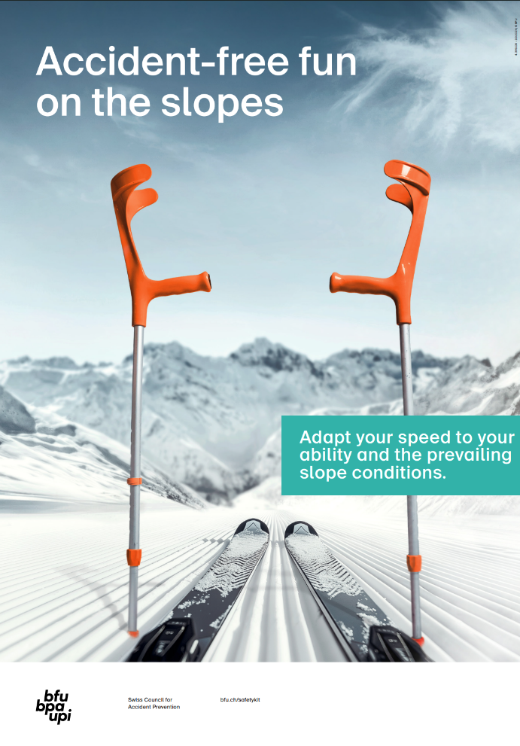
Over 90 % of skiing and snowboarding accidents are self-caused.
Follow these tips to get the most out of your day on the slopes.

Slide 4
Know your limits
Protect yourself
Find your space

Slide 5
Know your limits

Slide 6
Know your limits
Be prepared: Adopt the right mindset and warm up before hitting the slopes.
Exercise your core and leg muscles and train your balance.
Take a course to improve your technique under guidance.
Adapt your speed.

Slide 7
Adapt your speed
Skiers and snowboarders are often travelling faster than they might think – it takes no time at all to reach a speed of 50 km/h.
A collision with a stationary obstacle at this speed is comparable to a fall from 10 metres height.

Slide 8
Know your limits
Be prepared: Adopt the right mindset and warm up before hitting the slopes.
Adapt your speed.
Take breaks.

Slide 9
Know your limits
Protect yourself

Slide 10
Protect yourself
Wear a helmet.

Slide 11
Ski/snowboard helmet
Try when you buy, the helmet should neither pinch nor wobble.
The helmet should also fit well when worn with ski goggles – without pinching or wobbling.
Adjust the chin straps – there should be a finger’s width between chin and strap.
→ Helmets with rotation-damping systems, e.g. MIPS or WaveCel, provide even better head protection.

Slide 12
Protect yourself
Wear a helmet.
Protect your body.

Slide 13
Body protection
Wrist protectors for novice snowboarders
Back protector, especially when riding in snow parks
Contact lenses or prescription glasses
Ski goggles with UV protection
Functional clothing

Slide 14
Protect yourself
Wear a helmet.
Protect your body.
Check your skis and snowboard.

Slide 15
Skis and snowboard
Maintain your skis/snowboard – sand the edges and wax the runners.
Replace any defective parts.
Snowboarders: Adjust the binding and tighten any loose screws.
Skiers: Have your ski bindings set every year by a specialist retailer and checked on a testing device.

Slide 16
Know your limits
Protect yourself
Find your space

Slide 17
Find your space
Leave enough room for other piste users (FIS rules 1, 3, 4, 5).
Stop where you can easily be seen.
Obey all signage and markings.

Slide 18
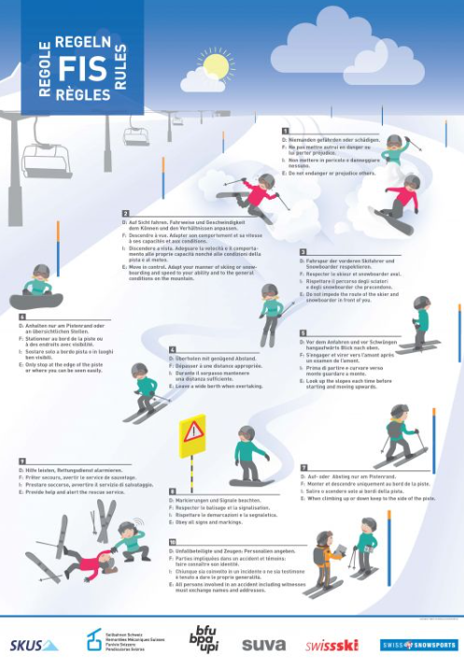
Keep track of the rules
The International Ski Federation (FIS) rules of conduct and the guidelines of the Swiss Commission for the Prevention of Accidents on Snowsports Infrastructure (SKUS) apply to all users of snowsports infrastructure.

Slide 19
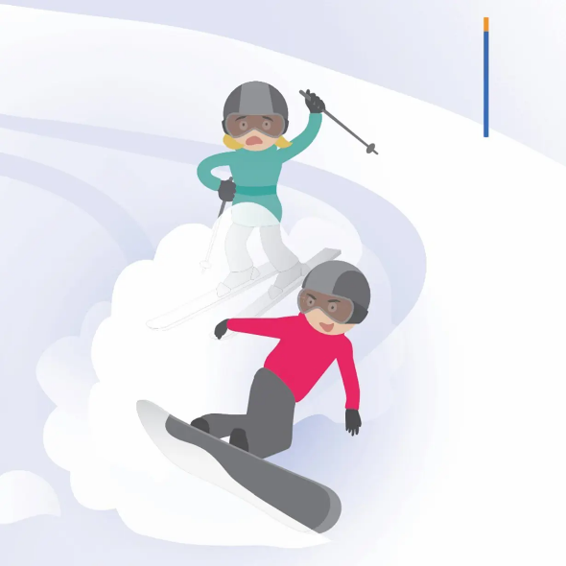
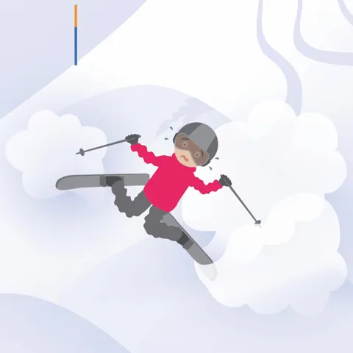
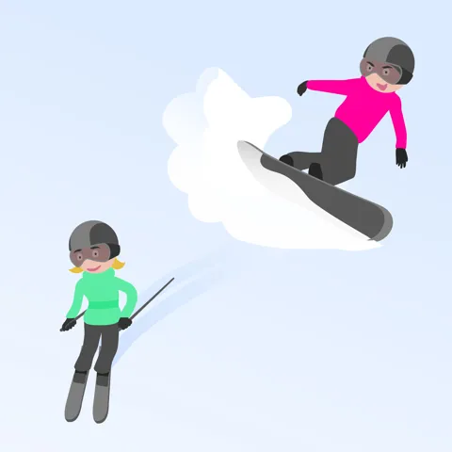
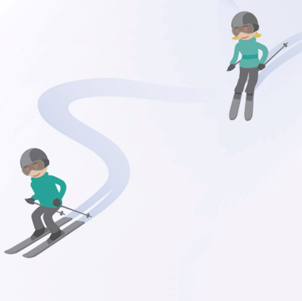
FIS Rules
1.
Do not endanger or harm anyone.
2.
Be in control; adapt your style and speed to your ability and the conditions.
3.
Respect the route of the skiers and snowboarders ahead of you.
4.
Leave sufficient room when overtaking.

Slide 20
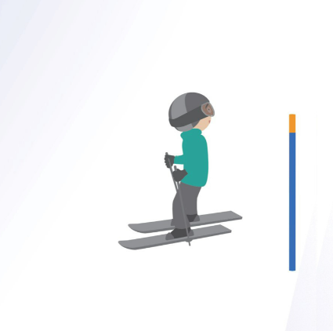
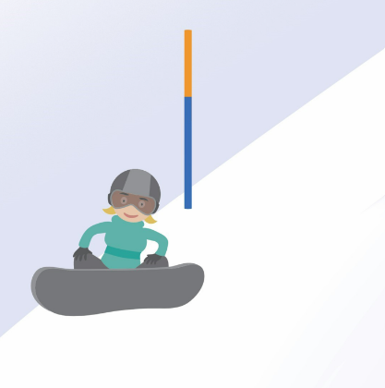
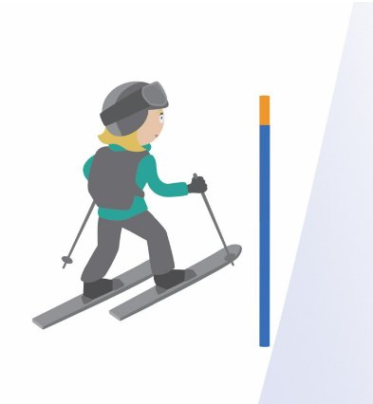
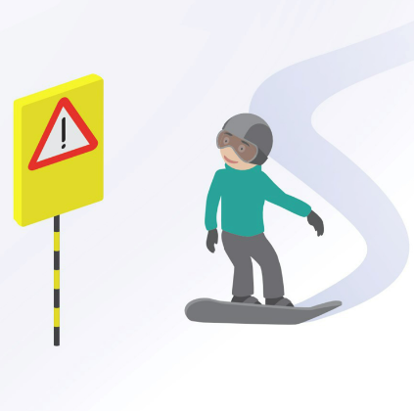
FIS Rules
5.
Look up the slope before setting off or turning.
6.
Only stop at the edge of the piste or where you can be easily seen.
7.
When ascending or descending, keep to the edge of the piste.
8.
Obey all signage and markings.

Slide 21
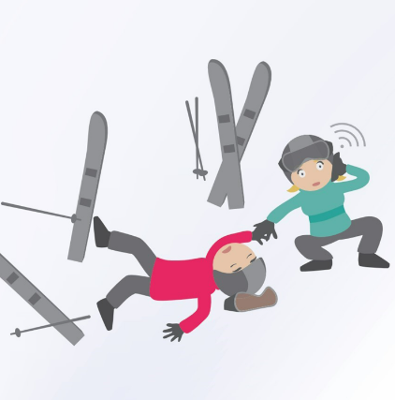
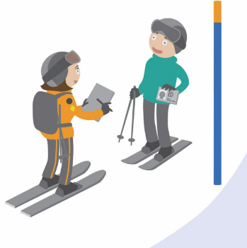
FIS Rules
9.
Provide assistance, alert the emergency services.
10.
If you are involved in or witness an accident: leave your personal details.

Slide 22
SKUS Rules
1. Always place your snowboard binding-side down in the snow.
2. Release your rear leg from the binding on ski lifts and chairlifts.

Slide 23
Video “Get piste perfect”

Slide 24
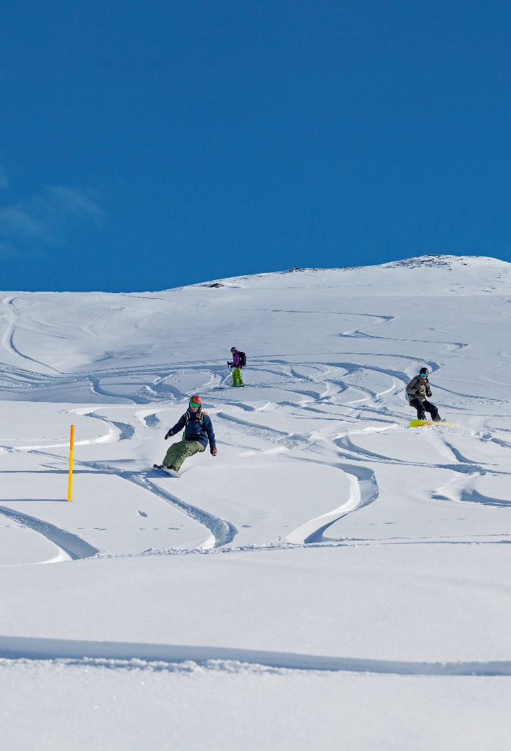
Freeriding: Five key tips
When deep-snow skiing, use the secured, yellow-marked runs.
If you want to leave the secured runs: take an avalanche course and/or ...
... join a group led by an experienced guide.
Get up-to-date info on the current conditions.
Carry a charged mobile phone and emergency equipment: avalanche transceiver (rescue beacon), probe, shovel
An avalanche airbag backpack is recommended.

Slide 25
Video “Safer off-piste”

Slide 26
More information
More accident prevention tips: bfu.ch

